Slide 1
Insertion and Mergesort integration
SC2001 Project 1
SS2 Group 7:
Aloysius Ng, Fabian Tay, Yannaroj Chua

Slide 2
Part (a): Algorithm Implementation
Implementation of Hybrid Sort Algorithm
Recursively divide the input array
When the sub-array size becomes <= S after certain number of divisions, we switch to using Insertion Sort.
We then merge the individually sorted arrays using Merge Sort.

Slide 3
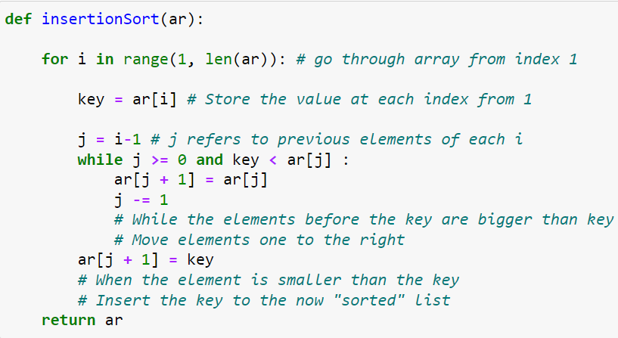
Part (a): Algorithm Implementation

Slide 4
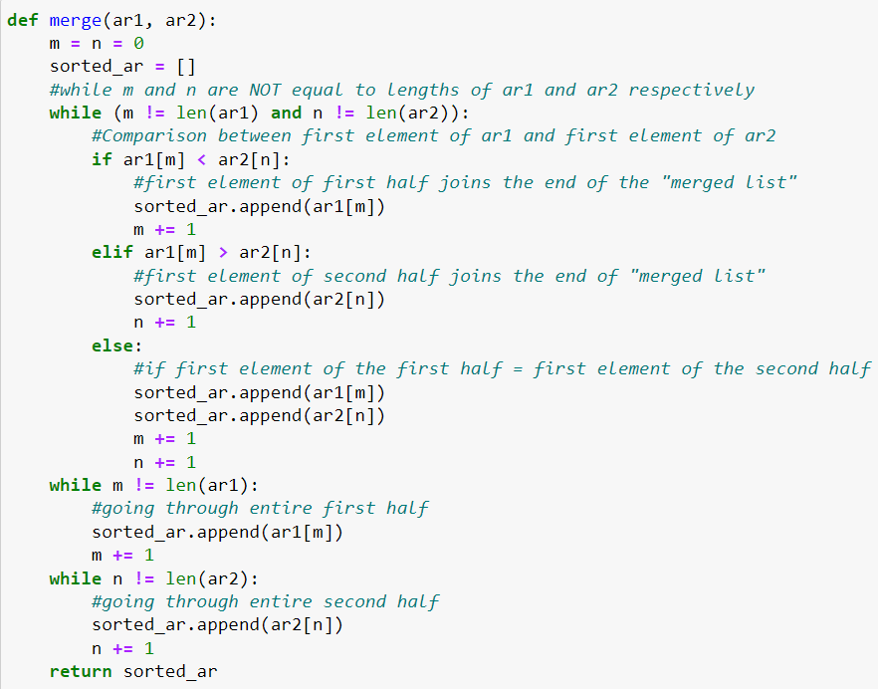
Part (a): Algorithm Implementation

Slide 5
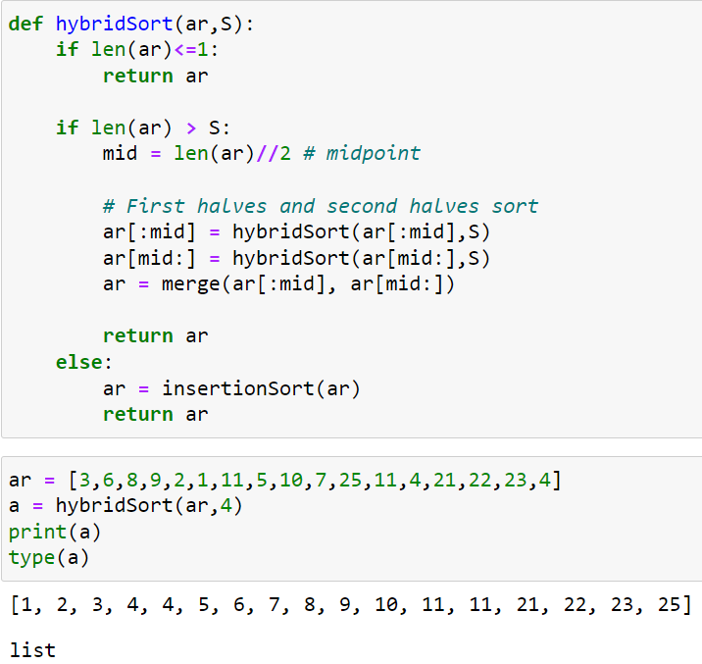
Part (a): Algorithm Implementation

Slide 6
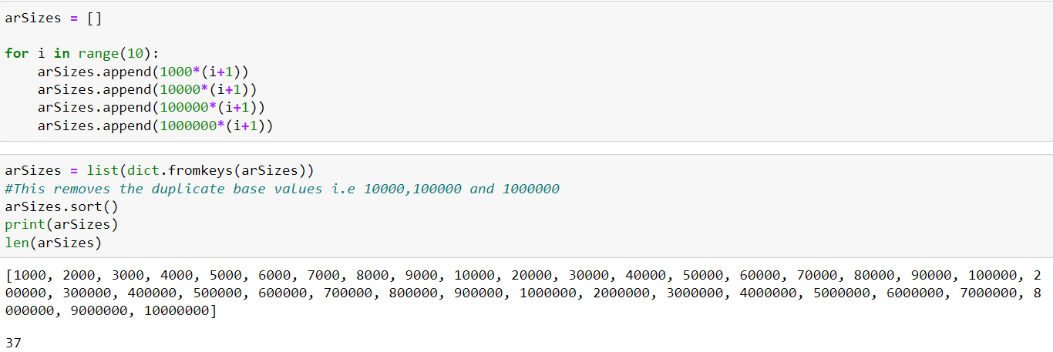
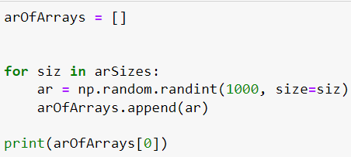
Part (b): Generate Input Data

Slide 7
Part (c): Analysis of Time Complexity
i. With the value of S fixed, plot the number of key comparisons over different sizes of the input list n. Compare your empirical results with your theoretical analysis of the time complexity.

Slide 8
Part (c): Analysis of Time Complexity
Theoretical analysis of time complexity:
For worst case,
T(n) = [n-1 + n-2 + n-4 +.....+n-2^{lg(n/S)-1}] + [(n/S)(time complexity of insertion sort)]
= [n lg(n/S) - (1 + 2 + 2² + 2³ + … + 2^{lg(n/S)-1})] + [(n/S)(time complexity of insertion sort)]
= n lg(n/S) - (n/S - 1) + (n/S)(time complexity of insertion sort)
For average case of insertion sort,
T(n) = n lg(n/S) - (n/S - 1) + (n/S)[(¼)(s-1)(s+2)]

Slide 9
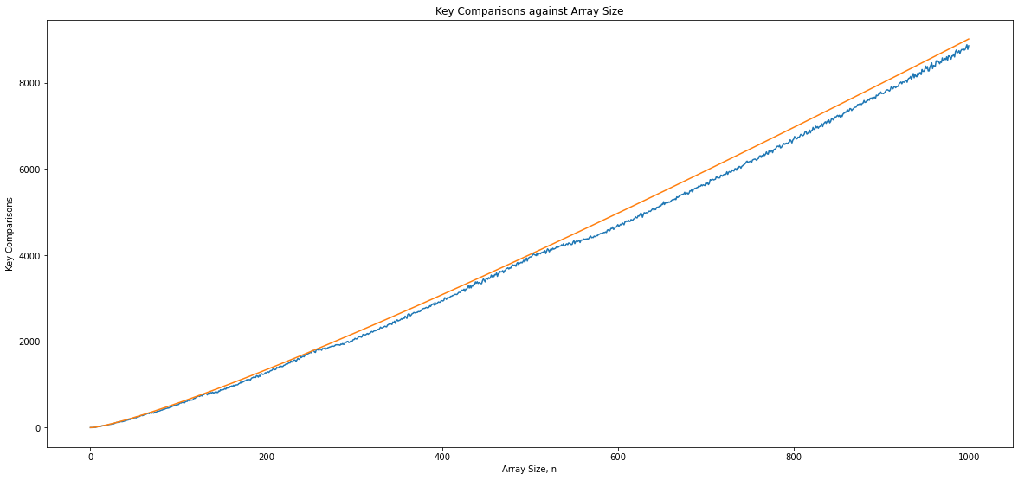
Part (c): Analysis of Time Complexity
(orange line = theoretical, blue line = empirical)
Value of S = 8

Slide 10
Part (c): Analysis of Time Complexity
ii. With the input size n fixed, plot the number of key comparisons over different values of S. Compare your empirical results with your theoretical analysis of the time complexity.

Slide 11
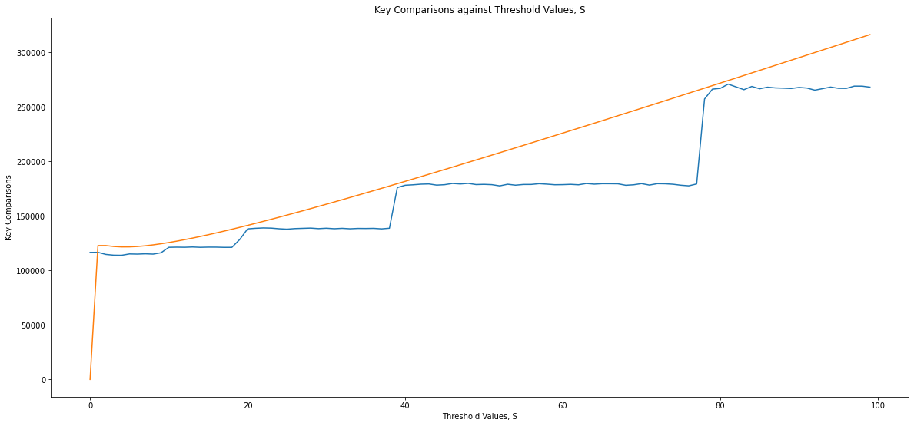
Part (c): Analysis of Time Complexity
(orange line = theoretical, blue line = empirical)
Input size n = 10000

Slide 12
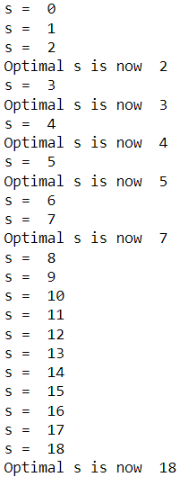
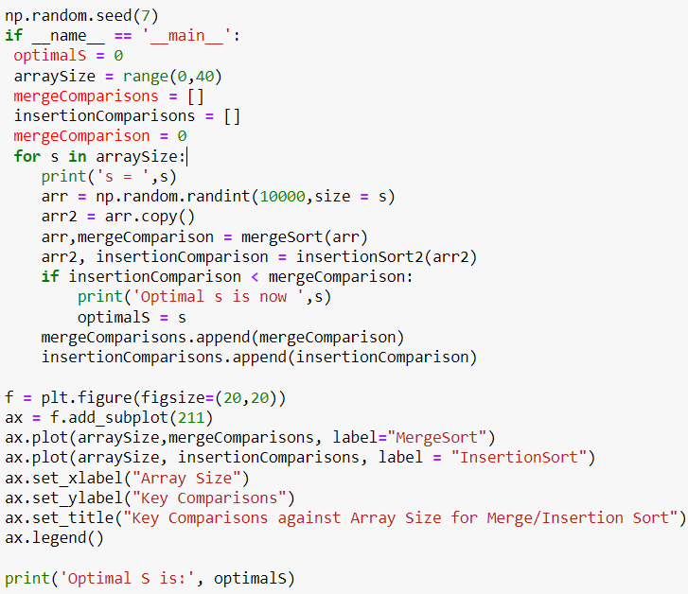
Part (c): Analysis of Time Complexity
iii. Using different sizes of input datasets, study how to determine an optimal value of S for the best performance of this hybrid algorithm.

Slide 13
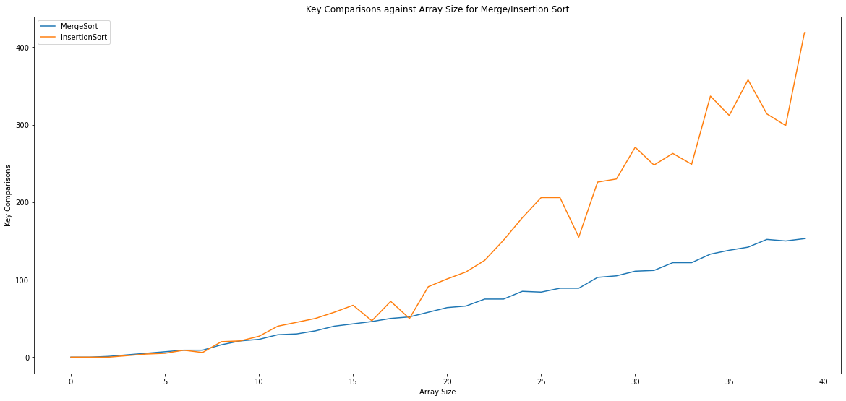
Part (c): Analysis of Time Complexity
iii. Using different sizes of input datasets, study how to determine an optimal value of S for the best performance of this hybrid algorithm.

Slide 14
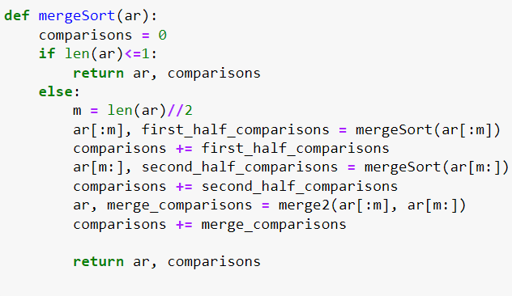
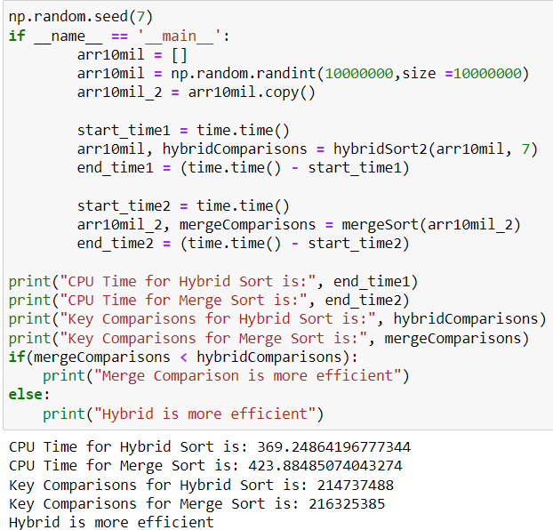
Part (d): Comparison with original Mergesort

Slide 15
Conclusion
We observe that Hybrid Sort is more efficient than Merge Sort in terms of shorter CPU time and also lesser key comparisons when S=7.
Therefore the optimal value of S we have determined is 7, derived through comparisons of the graphs shown earlier.

